Slide 1
Overview of BLS food price data
Steve Reed
AEAA Post Conference Workshop on Food Prices and Forecasting
August 1, 2024

Slide 2
BLS price programs
MXP Import and Export Price Indexes
PPI Producer Price Index
CPI Consumer Price Index
Indexes
Average prices

Slide 3
MXP Food price data
MXP measures changes in transaction prices of goods and selected services that are imported into and exported from the United States.
Both import and export price data include many food categories, though granularity is limited
Most widely used products include export and import end use indexes, Locality of Origin (LOO) indexes, Locality of Destination(LOD) indexes

Slide 4
PPI food price data
The Producer Price Index (PPI) is a family of indexes that measures the average change over time in selling prices received by domestic producers of goods and services.
Hundreds of food indexes, including broad aggregates and granular categories available. The PPI includes multiple structures; we will focus on commodity indexes.
Prices are from perspective of the seller and do not include taxes.

Slide 5
CPI food price index data
CPI measures the change in price paid by consumers (individuals and households), including sales and excise taxes
Major aggregates: Food, food at home, food away from home
Sub-aggregates like Cereals and bakery products or fruits and vegetables
Dozens of more detailed categories
Regional and metro area data also available, with less granularity

Slide 6
CPI food price index detail
Category | Relative importance | 12-month change, June 2024
Fruits and vegetables | 1.388 | -0.5
Fresh fruits and vegetables | 1.049 | -1.0
Fresh fruits | 0.559 | -1.7
Apples | 0.067 | -12.0
Bananas | 0.084 | 0.9
Citrus fruits⁽⁴⁾ | 0.157 | 1.2
Oranges, including tangerines⁽⁵⁾ |  | 3.0
Other fresh fruits⁽⁴⁾ | 0.251 | -0.8
Fresh vegetables | 0.49 | -0.3
Potatoes | 0.075 | -3.9
Lettuce | 0.067 | 2.5
Tomatoes | 0.077 | -1.1
Other fresh vegetables | 0.272 | 0.7
Processed fruits and vegetables⁽⁴⁾ | 0.339 | 1.1
Canned fruits and vegetables⁽⁴⁾ | 0.166 | 2.3
Canned fruits⁽⁴⁾⁽⁵⁾ |  | 2.2
Canned vegetables⁽⁴⁾⁽⁵⁾ |  | 2.6
Frozen fruits and vegetables⁽⁴⁾ | 0.104 | -1.8
Frozen vegetables⁽⁵⁾ |  | -1.3
Other processed fruits and vegetables including dried⁽⁴⁾ | 0.069 | 2.3
Dried beans, peas, and lentils⁽⁴⁾⁽⁵⁾ |  | 4.8
Category | Relative importance | 12-month change, June 2024
Cereals and bakery products | 1.050 | 0.5
Cereals and cereal products | 0.312 | -1.2
Flour and prepared flour mixes | 0.051 | 0.9
Breakfast cereal | 0.124 | -1.4
Rice, pasta, cornmeal | 0.137 | -1.9
Rice⁽⁴⁾⁽⁵⁾ |  | -2.4
Bakery products | 0.737 | 1.3
Bread⁽⁴⁾ | 0.198 | 1.1
White bread⁽⁵⁾ |  | 0.5
Bread other than white⁽⁵⁾ |  | 1.8
Fresh biscuits, rolls, muffins⁽⁴⁾ | 0.114 | 1.9
Cakes, cupcakes, and cookies | 0.187 | 0.3
Cookies⁽⁵⁾ |  | 0.5
Fresh cakes and cupcakes⁽⁵⁾ |  | -0.2
Other bakery products | 0.238 | 2.2
Fresh sweetrolls, coffeecakes, doughnuts⁽⁵⁾ |  | 0.6
Crackers, bread, and cracker products⁽⁵⁾ |  | 4.1
Frozen and refrigerated bakery products, pies, tarts, turnovers⁽⁵⁾ |  | 1.6

Slide 7
CPI average food price data
Actual dollars and cents prices of dozens of selected food items. Mostly measured in dollars per pound.
Generally based on a more narrowly defined subset of the sample used for index data
May move quite differently than index data

Slide 8
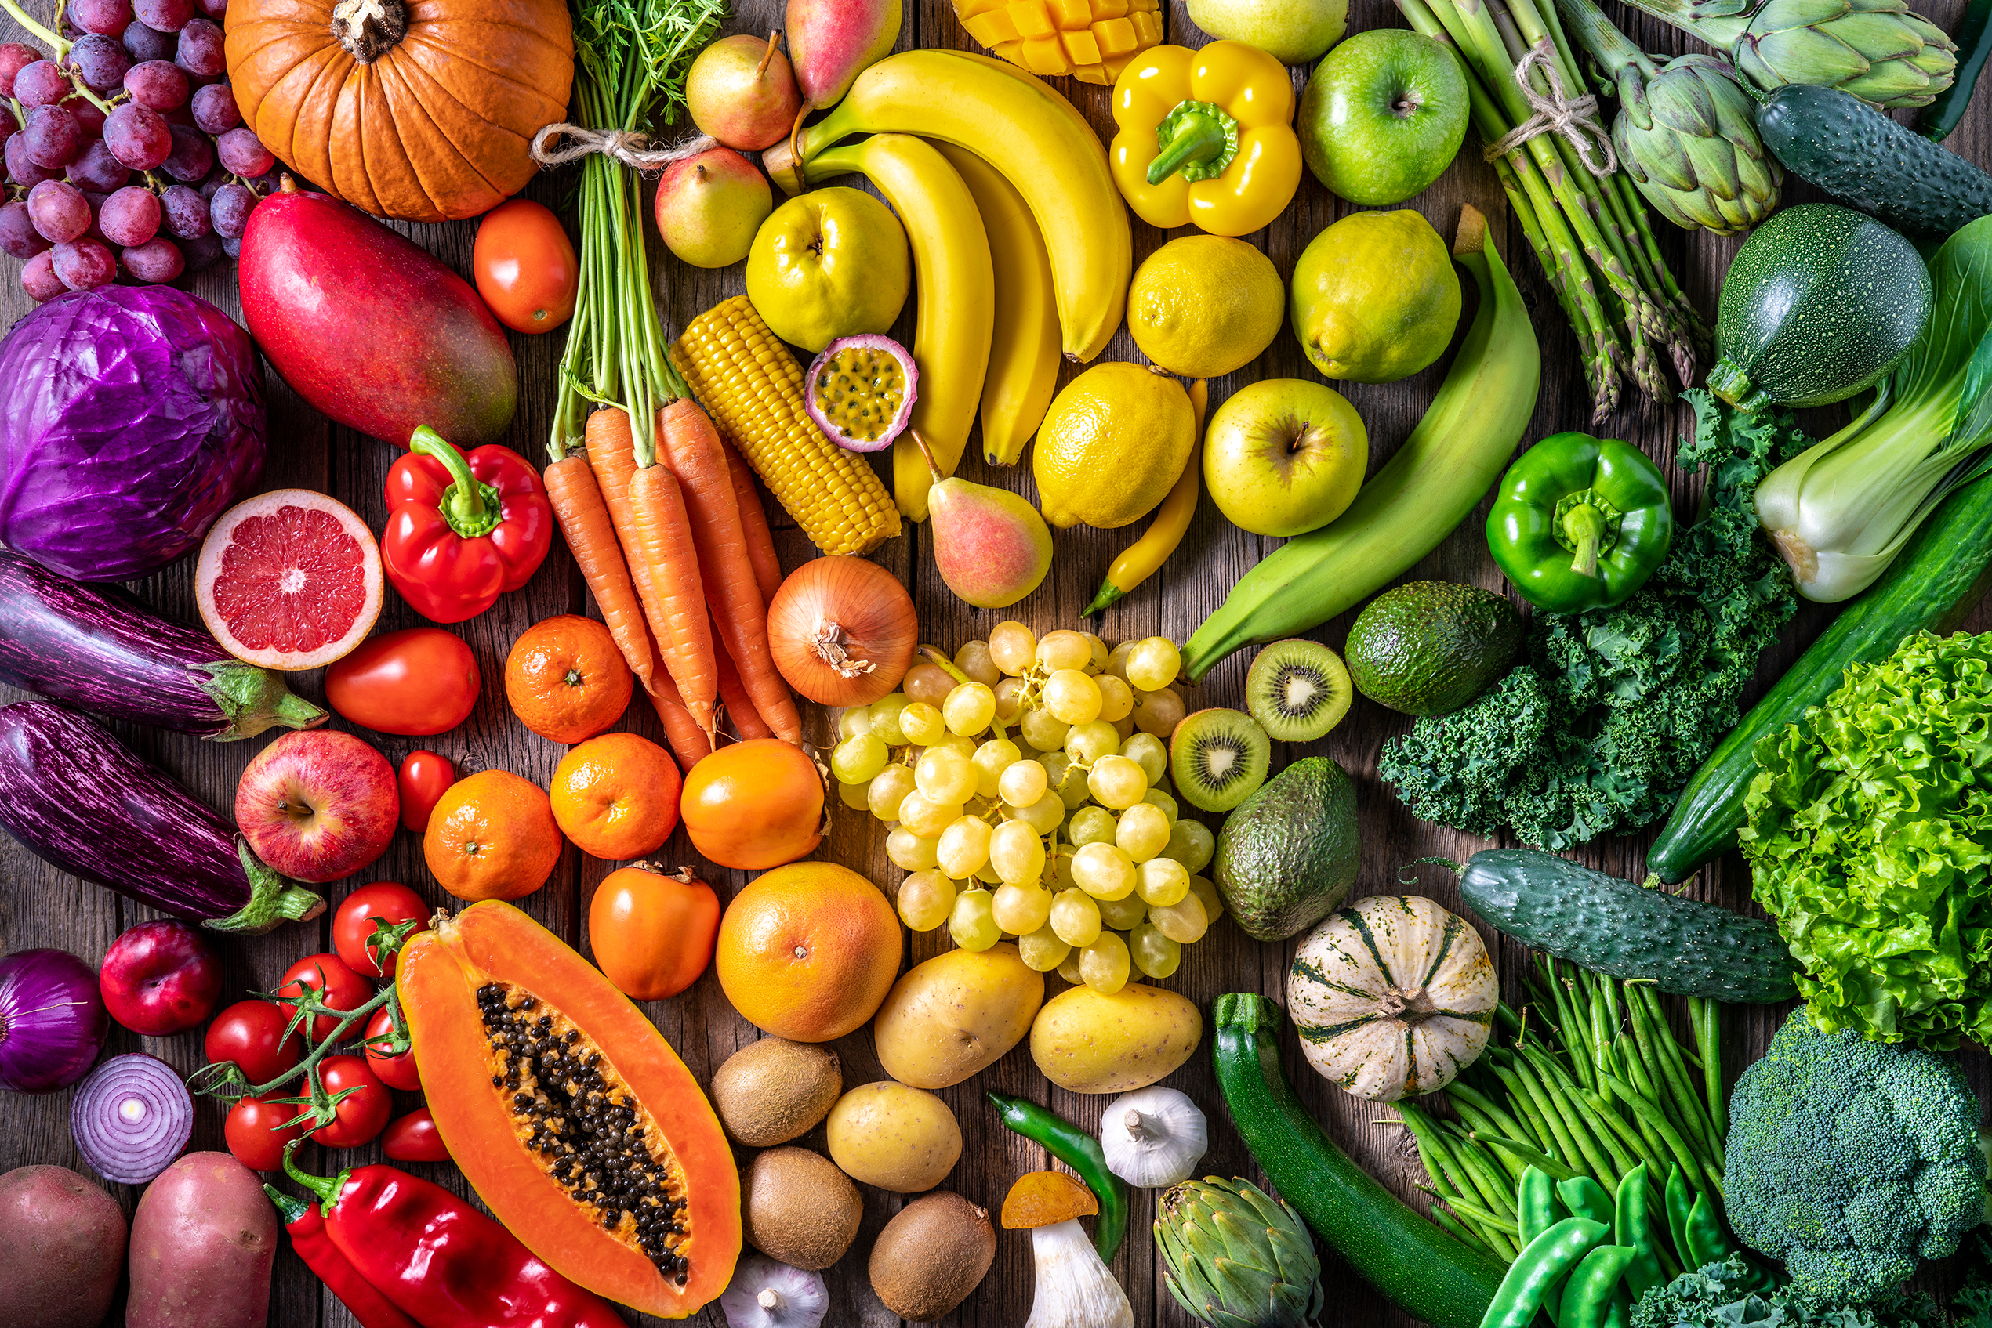
Example: Fruit prices in the U.S. economy

Slide 9
Fruit export prices

Slide 10
Fruit import prices

Slide 11
Producer fruit prices

Slide 12
Consumer fruit Prices

Slide 13
BLS fruit price indexes

Slide 14
CPI average food prices, June 2024

Slide 15
Contact information
Steve Reed
Consumer Price Index Program
www.bls.gov/cpi
202-691-5378
reed.steve@bls.gov

Slide 16
BLS contact information
www.bls.gov
www.bls.gov/cpi
CPI info phone: 202 691 7000
CPI info email: cpi_info @bls.gov

